Slide 1
Powerpuff Connect Bank of Baroda Hackathon 2024
Pride & Power
With a blend of creativity, technology, and strategic insight, the Pride & Power team crafts tailor-made marketing solutions that empower brands to connect with their audiences in meaningful and impactful ways
25 June 2024

Slide 2
Problem Statement?
Why did you decide to solve this Problem statement?
Amitabh Roy is a marketing manager at Bank of Baroda. He is tasked with promoting a newly launched deposit scheme designed specifically for high-net-worth individuals. To achieve this, Amitabh first requests a list of customers who fall into this category.
Once he has the list, he collaborates with several content authors to create marketing materials. These materials go through several review cycles, and Amitabh shortlists the best content. However, reaching out to each customer individually to address their personal needs is not feasible.
Customers often do not understand the benefits of the new product or services unless the marketing content is tailored to their personal preferences. This lack of personalization can result in a low conversion rate for the campaign, which would be seen as unsuccessful and could raise concerns about Amitabh's performance.
Amitabh is really worried about how to optimize the entire process to improve engagement and conversion rates.

Slide 3
Prerequisite
What are the alternatives/competitive products for the problem you are solving?
Adobe Experience Cloud
Salesforce Marketing Cloud
more…

Slide 4
Tools or resources
Azure tools or resources which are likely to be used by you for the prototype, if your idea gets selected
AOAI GPT 4o
AOAI LLM
DALL-E
pgvector on Azure Database for PostgreSQL
more…

Slide 5
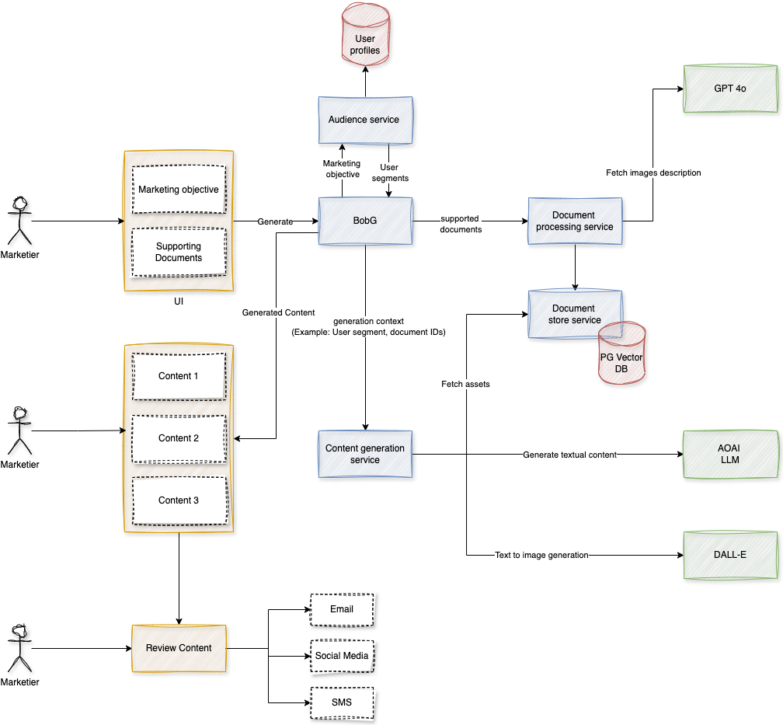
Any Supporting Functional Documents
Present your solution, talk about methodology, architecture & scalability

Slide 6
Key Differentiators & Adoption Plan
How is your solution better than alternatives and how do you plan to build adoption?
Personalised and brand-aware content
High engagement
TIme and cost optimisations

Slide 7
GitHub Repository Link & supporting diagrams, screenshots, if any
How far it can go?
One solution can fit all enterprises.
Plug and play with least configurations.
RAG enabled and high control over quality.

Slide 8
Business Potential and Relevance
What are the business applications of the problem you are solving?
Applicable for all enterprises which require marketing solutions.
Fit for both B2C and B2B enterprises.

Slide 9
Uniqueness of Approach and Solution
What is the unique aspects of the proposed idea?
End to end solution that provides an efficient marketing content authoring experience.
Reduces the authoring cycle from several days/weeks to a few minutes.
Granular level of control on the quality of the content.

Slide 10
User Experience
How will your idea enhance the user experience?
Multi-device support for the content authoring and review experience.
Responsive design to support all screen resolutions.
Accessibility compliance to make it usable for all.
Secure and authentic.
User feedback based continuous improvements.

Slide 11
Scalability
How effectively can your solution be scaled to accommodate growth without compromising performance?
Using azure cloud resources, each component in the architecture solution can be scaled efficiently as per the usage.
Telemetry and observability would help optimising resource usage.
Usage of asynchronous pipeline system like Kafka would help the systems to be operated without blocking resources like request threads.

Slide 12
Ease of Deployment and Maintenance
How simple is your solution to implement and maintain on an ongoing basis?
A microservice based solution where each component in the architecture can be developed and deployed independently without impacting other components. Deployments can be handled by any CI/CD tool like Jenkins.
Release cycle can be easily maintained by using multiple environments like Dev, Test, Stage and Prod.

Slide 13
Security Considerations
What measures are incorporated to ensure the security and integrity of your solution?
Cloud security is efficiently managed by azure.
Application security can be configured in many ways. Example allowing requests only from specific origins(CORS).
Authentication and authorisation can be built to support multiple user/roles combinations.

Slide 14
Thank You
Team member names
Sakshi Puri
Gaurav Makkar

